Slide 1
Business & Marketing, Digital Marketing & Social Media, & Economics
Mrs. Schafer

Slide 2
Intellectual Property
Patents
Trademarks
Copyrights
Fair Use
Open Source
Public Domain
Examples of lawsuits
Fair Use Questions

Slide 3
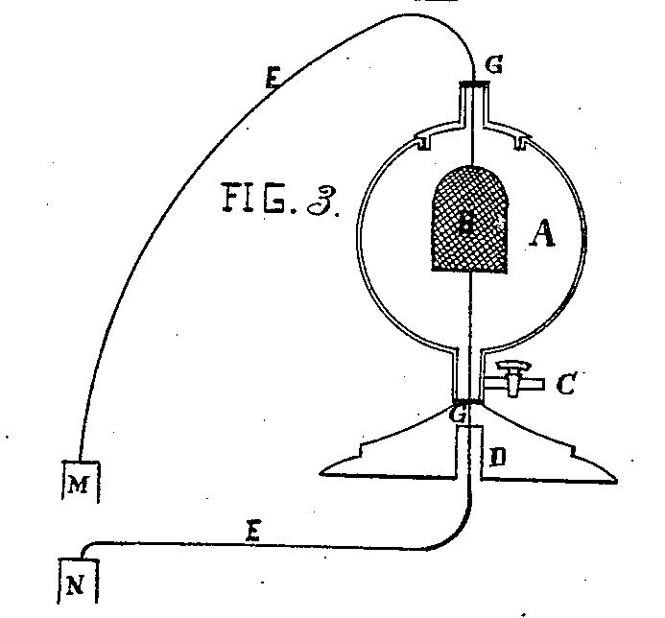


Types of Intellectual Property
Patent: inventions (including processes, machines, manufactured items)
Trademark: commercial names, phrases, and logos (don’t expire)
Copyright: creative or intellectual works
For what object is this the original patent picture?
Notes:
Certain computer programs may fall within the subject matter protected by both patents and copyrights.

Slide 4
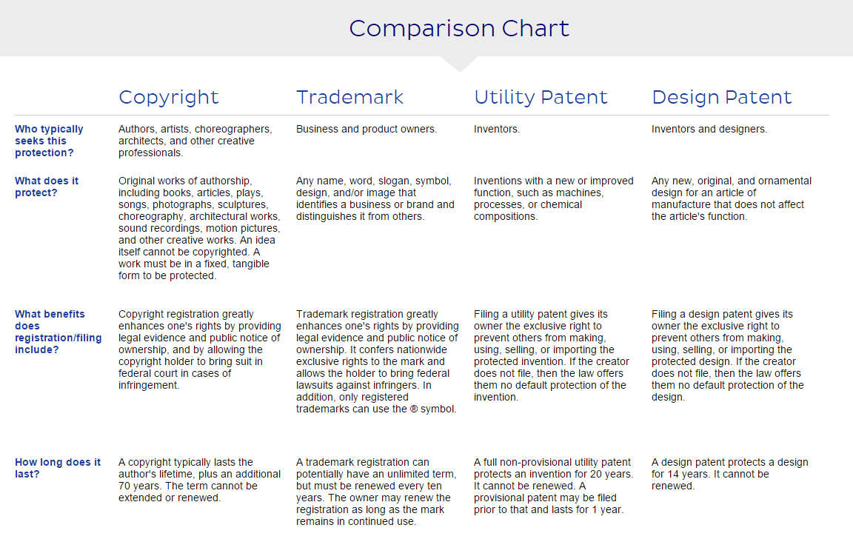
Comparison

Slide 5
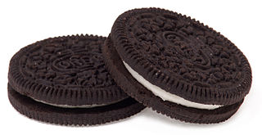
Bestselling Cookie Example
First mover advantage? Or is second mover the real advantage?
Read this article about competition and the world's most famous cookie. The best-selling cookie in the world is a copycat brand | CBC Radio
https://youtu.be/G4qaiopZK5U?si=ulrTxVk1iOkzoExm
Notes:
The best-selling cookie in the world is a copycat brand | CBC Radio

Slide 6
Showcase of Real Items
Copyright, Legal paperwork to retain Patent Lawyer, Trademark Issue, Patent Documents

Slide 7
What are the primary goals of patent law?
Notes:
To encourage innovation and commercialization of technological advances. Incentivizes investors to publicly disclose their inventions in exchange for certain exclusive rights.

Slide 8

What is the primary goal of patent law?
To encourage innovation and commercialization of technological advances.
Incentivize investors to publicly disclose their inventions in exchange for certain exclusive rights.

Slide 9
Copyrights

Slide 10
Documenting Copyright
Copyright happens AUTOMATICALLY upon creation!
You do not need to include a notice or symbol
You should register your work to protect your interests and notify the public.
Library of Congress, Copyright Office
If you should want to file a legal suit, your work must first be registered.
You may still assert a claim for infringement if not registered, but most benefits from the law are only available through the formal process
Notes:
A person does not have to register their work because copyright happens automatically (immediately) upon creation of the work. Thus you do not need to include a copyright notice or symbol. However, it is strongly advised that people register their work with the Copyright Office to protect their interests and notify the public. Plus, if you should want to file a legal suit against a copyright infringement, your work must first be registered.
“Because current copyright law automatically “protests” original artwork from the moment it is created, even without a copyright notice, an artist always has the right to assert a claim for copyright infringement even if he or she has not previously registered the work in question…Artworks are protected, whether or not they are published or registered. However, the bulk of the benefits that the copyright law offers to artists are available only through formally registering the art with the U.S. Copyright Office…” ~Graphics Artists Guild Handbook
Changes to an original work is known as a derivative.

Slide 11
Registering Your Work
Paper/Mail ~$65
Online ~$35
Also need to submit photos and/or copies of the work
Can register several un-published items together (cheaper) as a “collection”
Notes:
Copyright Registration
To register your work, contact the Library of Congress, Copyright Office. Of course there are forms to fill out and a fee.
Paper/Mail ~$65
Online ~$35
Also need to submit photos and/or copies of the work
Can register several un-published items together (cheaper) as a “collection”
“It is more economical for an artist to register all images for a job, including rough sketches, as an unpublished collection for one fee as soon as finals are submitted to the client. Otherwise, once the final artwork is published, it has to be registered separately from the unpublished images that were created for the same job. To make sure that copyright registration occurs – and happens in a timely manner – it should be a routine function scheduled in the artist’s workflow for a project or assignment. Although registration fees should not be charged to the client as line items, they should be figured into the artist’s cost of doing business when calculating rates.” ~Graphics Artists Guild Handbook
The Copyright Act of 1909 required that copyrights expiring after the initial 28-year term had to be renewed… Because of this onerous provision, many valuable works, such as the famous Frank Capra movie It’s a Wonderful Life fell into the public domain, to the detriment of their creators or the creators’ heirs. In 1992, the Automatic Renewal Act was passed to protect the “windows and orphans” of authors who did not, or could not, register the copyright’s renewal.”
Optional Activity:
US Copyright Office Questions

Slide 12
Documenting Copyright
To document copyright, you must include:
The symbol, word or abbreviation © - “Copyright” - “Copr.”
The first year of publication (or the first year of the derivative work)
The name of the owner of the copyright
For audio work, a verbal statement is acceptable
Example: © 2005 Jane Doe
Notes:
**To document copyright, you must include:
The symbol © or the word “Copyright” or the abbreviation “Copr.”
The first year of publication or the first year of the derivative work
The name of the owner of the copyright
Example: © 2005 Jane Doe
For audio work, a verbal statement is acceptable.
The exclusive rights of copyrighted work may be transferred to another person. Officially, this must be done in writing. This could be done through a will. For example – who owns the rights to Elvis’ songs?

Slide 13
You May Use Someone’s Work If:
You receive (written) permission from the owner
You stay within the rules of “fair use”
The work is in the public domain
Notes:
When can you use someone else’s work?
If you receive written permission from the creator
If you stay within the rules of “fair use”
If it is in the public domain

Slide 14
Getting Permission
To obtain permission from a copyright owner, follow these steps
Identify and contact the owner
State your intended use
Set the terms
Negotiate payment (if required)
Get it in WRITING!
Notes:
Obtaining Permission
Identify the owner
State your intended use
Set the terms
Negotiate payment (if required)
Get it in WRITING!

Slide 15
Permission
Permission is known as “licensing.”
A permission agreement is defined as “exclusive” if you are the only person who can use the work.
Some organizations, known as collective rights organizations, act on behalf of multiple owners and can grant permission. Visit http://www.copyright.iupui.edu/permhome.htm for a list of such companies.
Notes:
Permission
Permission is known as “licensing.” A permission agreement is defined as “exclusive” if you are the only person who can use the work.
Collective rights organizations act on behalf of multiple owners
“For example, an artist creates an illustration for a magazine cover, but then the magazine wants to use it for a promotional poster. The magazine has to go back to the artist for another license to use it on the poster and pay the artist an additional fee for that use. If a graphic designer is hired to create logo for a company that wants widespread use of the logo on all its products and merchandise, the designer must be paid accordingly for transferring all the rights to the company so it can use the design in any way it wants.” ~Graphics Artists Guild Handbook

Slide 16
Fair Use
4 basic guidelines for using copyrighted work:
Purpose: No for commercial use. The use is for nonprofit, education, criticism, comment, news reporting, scholarship, or research. Favors transformative, not merely reproductions
Nature: The material is mainly facts (rather than creative expression),
Amount: Generally the more you use, the less likely you are within fair use. Small amounts are excessive if they take the “heart of the work”
Effect: Using the material is not taking potential sales away from the original work
The Fair Use Guidelines for Educational Multimedia is an interpretation of the Copyright Act of 1976. It is not a legal document, but is recognized by the House of Representatives’ Subcommittee on Courts and Intellectual Property
Notes:
Fair Use
The Fair Use Guidelines for Educational Multimedia is an interpretation of the Copyright Act of 1976. It is not a legal document, but is recognized by the House of Representatives’ Subcommittee on Courts and Intellectual Property.
Purpose: Copying is for nonprofit, educational use Criticism, comment, news reporting, teaching, scholarship, research
Nature: Material is mainly facts (rather than creative expression)
Amount: Small portions have been used to make a point (not whole sections) (approximately 10%)
Effect: Using the material is not taking potential sales away from the original work
**Good time to stop and do the Fair Use Checklist
Optional Activities:
Read the “Are tattoos a public display” which describes a controversy over Dennis Rodman. (p. 52, CP&S)
Mike Tyson’s Tattoo in the movie “The Hangover II”
http://www.marklitwak.com/the-hangover-ii-tyson-tattoo-copyright-infringement-suit.html
Evaluate a situation using the “Checklist for Fair Use.” (Possibly use a cover-band scenario)
Article - Cover Bands

Slide 17
Do you need to have all 4 factors?
Fair Use is a Balancing Test
To determine whether a use is or is not a fair use, always keep in mind that you need to apply all four factors. For example, do not jump to a conclusion based simply on whether your use is educational or commercial. You still need to evaluate, apply, and weigh in the balance the nature of the copyrighted work, the amount or substantiality of the portion used, and the potential impact of the use on the market or value of the work.
Not all factors need to weigh either for or against fair use, but overall the factors will usually lean one direction or the other. Also, the relative importance of the factors is not always the same. Your analysis should guide you to a conclusion.

Slide 18
Fair Use - Parody
A parody is an imitation of the characteristic style of some other work in a satirical or humorous way. Parodies are a special case.
To receive protection under the fair use guidelines, a work (parody) must
contain only enough of the original work to make it identifiable as a parody
create a new work that can stand on its own, while criticizing the original work
Notes:
Parody = imitating the characteristic style of some other work in a satirical or humorous way.
To receive protection under the fair use guidelines, a work must
contain only enough of the original work to make it identifiable as a parody
create a new work that can stand on its own, while criticizing the original work
For example, Weird Al Yankovic changed Michael Jackson’s “Beat It” into “Eat It.” On a side note though, Weird Al does get permission to make his adaptations. Parodies don’t go over too well because they tend to be negative. Saturday Night Live and other talk shows are known for turning common songs or themes into satire topics and comedy. (p. 56, CP&S)
Show SNL Skits https://en.wikipedia.org/wiki/List_of_Saturday_Night_Live_commercial_parodies
Amazon Echo https://www.youtube.com/watch?v=YvT_gqs5ETk (pause right at beginning to show product)
Downton Abbey https://www.youtube.com/watch?v=1khDR7yzZ0I
GE Appliances (for men) https://www.youtube.com/watch?v=vZRzJJcq6Rs
Star Wars (characters get old) https://www.youtube.com/watch?v=mCXkgFjfr9M
https://en.wikipedia.org/wiki/List_of_Saturday_Night_Live_commercial_parodies
Optional Activities:
Music Comparison – listen and read legal results
Listen to some Weird Al (He usually gets permission – read article regarding what he did when Lady Gaga wouldn’t give permission)
Read Metallica vs Napster Article #1 to the class which addresses the many people who are affected by music piracy (or, wait until “piracy” topic later)

Slide 19
What Is The Public Domain?
“The Public Domain is a body of intellectual material which is not copyright or under patent and may be used freely by the public.”
Certain government documents
Works that are no longer protected by copyright laws (patent or copyright has expired)
Work that the author has given explicit permission to use freely (no restrictions) = ‘I grant this to the public domain’
Known facts, data, or statistics
Notes:
What is the public domain?
“The Public Domain is a body of intellectual material which is not copyright or under patent and may be used freely by the public.”
Certain government documents
Works that are no longer protected by copyright laws (patent or copyright has expired)
Work that the author has given explicit permission to use freely (no restrictions) = ‘I grant this to the public domain’
Known facts, data, or statistics

Slide 20
When Does Material Enter The Public Domain?
70 years after the author’s death
70 years after the death of the last remaining co-author
95 years after the first publication by an unknown author, or 120 years from creation – which ever is shorter
95 years after the creation of works for hire
Notes:
When does copyrighted material become public domain?
70 years after the author’s death
70 years after the death of the last remaining co-author
95 years after the first publication by an unknown author, or 120 years from creation – which ever is shorter
95 years for works for hire
These are the current laws that pertain to work created after 1978. Before 1978, copyright protection took effect when the work was published with a copyright notice or when it was registered. And, the length of protection was different. You must know when the original work was created in order to know which laws apply to it.
Compare Beethoven vs. Elvis’ music
See Changes due to 1998 Legislature

Slide 21
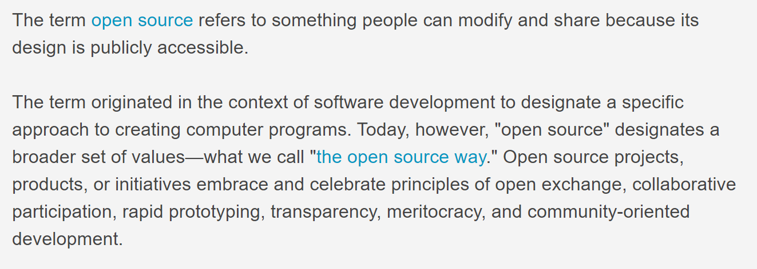
Open Source
https://opensource.com/resources/what-open-source

Slide 22
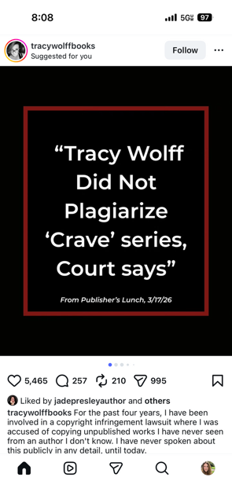
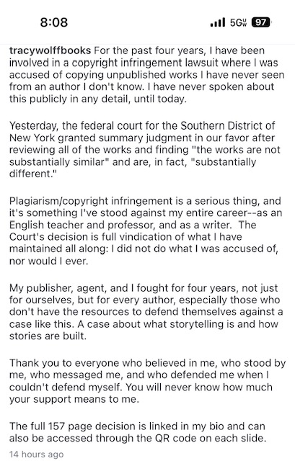
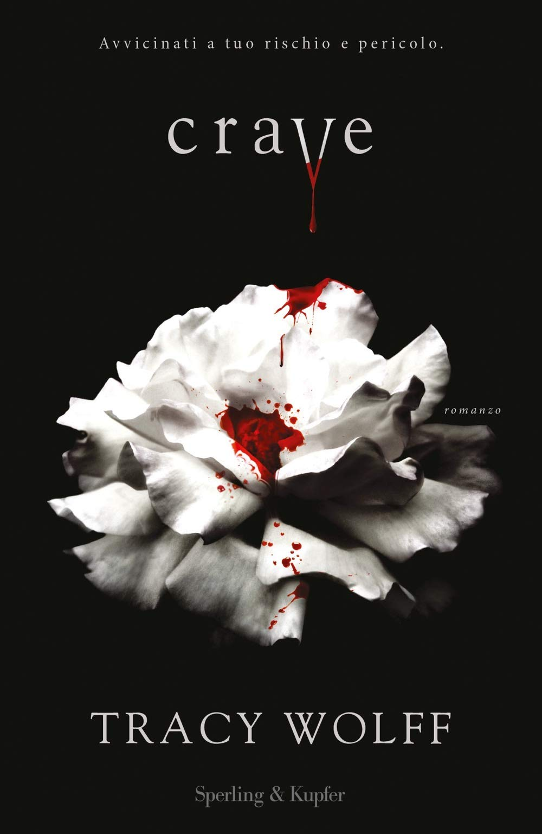

Slide 23
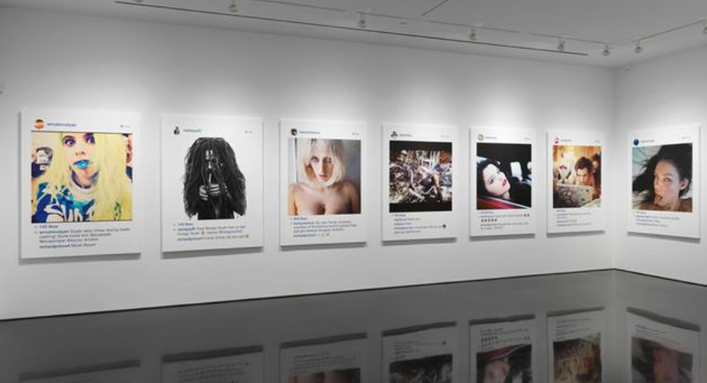
Artist Steals Instagram Photos and Sells Them for 100K at NYC Gallery

Slide 24
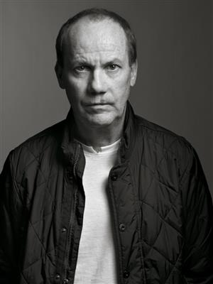
Richard Prince was sued. Did he win or lose?

Slide 25
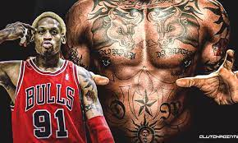
Dennis Rodman’s Tattoos
ARE THEY TRADEMARKS?

Slide 26
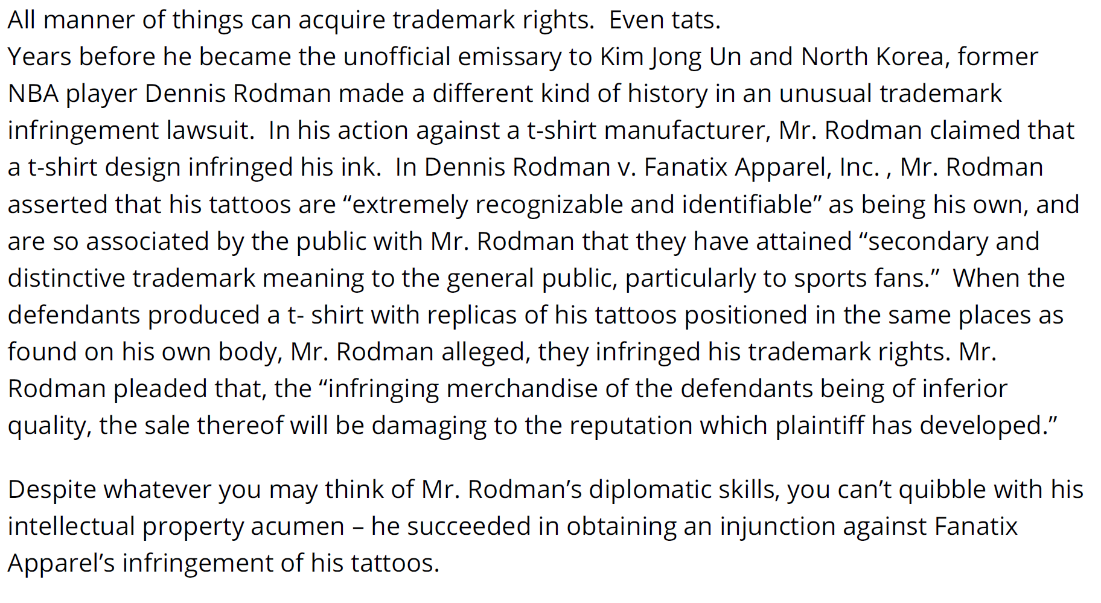
Dennis Rodman’s Tattoos—ARE THEY TRADEMARKS?

Slide 27
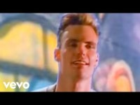
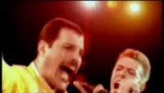
Songs That Sound Strangely Similar
Queen/David Bowie– Under Pressure (1981)
Vanilla Ice – Ice Ice Baby (1989)
Queen/David Bowie sued Vanilla Ice? Do you think they won or lost?
Notes:
David Bowie & Freddie Mercury - Under Pressure – YouTube
Vanilla Ice - Ice Ice Baby (Official Music Video) – YouTube
David Bowie & Freddie Mercury - Under Pressure (youtube.com)

Slide 28
Songs That Sound Strangely Similar
Queen – Under Pressure
Vanilla Ice – Ice Ice Baby
Vanilla Ice became a household word for a while, not because of his talent, but because of the copyright infringement that occured in 1990 when it came to light that he had sampled Queen and David Bowie’s “Under Pressure” without consent or license. Ice Ice Baby hit number one on the charts in the United States and Vanilla Ice became the one ‘under pressure’. Vanilla Ice altered the rhythm of the baseline thinking he would thereby avoid any question of credit, royalties, license or even permission. This case never went to court as it was clear that Vanilla Ice had stolen the sample without permission. He settled out of court with Queen and David Bowie for an undisclosed but very likely very high amount. Ice Ice Baby has been released in many different versions, since then, with all of the legal procedures followed.

Slide 29
USE THE FAIR USE GUIDE TO HELP ANSWER THESE QUESTIONS!

Slide 30
Patents, trademarks, and copyrights are all used to protect an individual or a company’s ______
financial assets
tangible assets
business equipment
intellectual property

Slide 31
Patents, trademarks, and copyrights are all used to protect an individual or a company’s ______
intellectual property intellectual property refers to the intangible business assets resulting from thinking processes. The three main types of intellectual property are patents, trademarks, and copyrights. These protect an individual or company’s rights to the intellectual property, but do not protect tangible assets such as business equipment or financial holdings.

Slide 32
A student purchases the Adobe Photoshop computer software and installs it onto her personal computer. She then gives it to her friend to download onto her new laptop. Is this OK since the student gave her friend permission to download it?

Slide 33
A student purchases the Adobe Photoshop computer software and installs it onto her personal computer. She then gives it to her friend to download onto her new laptop. Is this OK since the student gave her friend permission to download it?
NO – Installing borrowed software puts a copy of that software on your hard drive – which is an illegal copy, unless the user’s license from the copyright holder gives permission to install the software on multiple users’ computers.

Slide 34
A student finds his favorite band’s music on a file-sharing network that offers free music downloads. The student decides to download the music files at no cost rather than purchasing the CD. Is this copyright infringement?

Slide 35
A student finds his favorite band’s music on a file-sharing network that offers free music downloads. The student decides to download the music files at no cost rather than purchasing the CD. Is this copyright infringement?
YES – The student needs to get permission from the copyright owner before downloading the music.

Slide 36
Can you use other youtuber’s content?

Slide 37
Can you use other youtuber’s content?
Only if the other youtuber or YouTube gives you permission.

Slide 38
Can a remix or mashup of a song infringe copyright?

Slide 39
Can a remix or mashup of a song infringe copyright?
YES

Slide 40
Does uploading a video of yourself singing a cover song to YouTube require the permission of the copyright holder?

Slide 41
Does uploading a video of yourself singing a cover song to YouTube require the permission of the copyright holder?
YES

Slide 42
Are DJ mixes fair use?

Slide 43
Are DJ mixes fair use?
NO

Slide 44
A professor copies one article from a periodical for distribution to the class.

Slide 45
A professor copies one article from a periodical for distribution to the class.
FAIR USE? Yes. Distribution of multiple copies for classroom use is fair use. However, the repeated use of a copyrighted work, from term-to-term, requires more scrutiny in a fair use evaluation. Repeated use, as well as a large class size, may weigh against fair use.

Slide 46
A professor wishes to use a textbook he considers to be too expensive. He makes copies of the book for the class.

Slide 47
A professor wishes to use a textbook he considers to be too expensive. He makes copies of the book for the class.
FAIR USE? No. Although the use is educational, the professor is using the entire work, and by providing copies of the entire book to his students, he has affected the market. This conduct clearly interferes with the marketing monopoly of the copyright owner. The professor should place a copy on reserve or require the students to purchase the book.

Slide 48
A teacher wishes to show a copyrighted motion picture to her class for instructional purposes.

Slide 49
A teacher wishes to show a copyrighted motion picture to her class for instructional purposes.
FAIR USE? Yes, since it is for classroom instruction and no admission fee is charged. Tuition and course fees do not constitute admission fees.

Slide 50
A teacher or student prepares and gives a presentation that displays photographs. Permission was not obtained to use the photographs.

Slide 51
A teacher or student prepares and gives a presentation that displays photographs. Permission was not obtained to use the photographs.
FAIR USE? Yes. The copyright fair use provision explicitly provides for classroom use of copyrighted material. Instructors and students may perform and display their own educational projects or presentations for instruction.

Slide 52
A teacher or student creates a presentation and incorporates copyrighted music into the background. Assume that permission was not obtained to use the music for the presentation. Can the music be included in the teacher's or student's initial presentation?

Slide 53
A teacher or student creates a presentation and incorporates copyrighted music into the background. Assume that permission was not obtained to use the music for the presentation. Can the music be included in the teacher's or student's initial presentation?
FAIR USE? Yes. This is fair use if instruction is occurring.

Slide 54
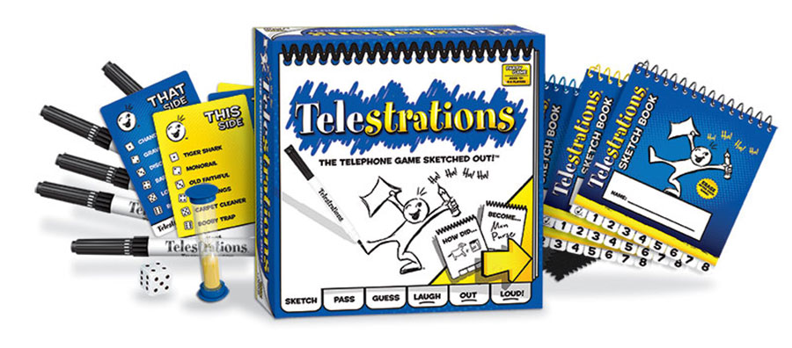
The importance of getting an idea patented

